Slide 1
Deepfake Video Detection Using Convolutional Vision Transformer
Deressa Wodajo Deressa
December 2020

Slide 2

Outline:
Introduction
Related Work
Design of Model for Deepfake Video Detection
Implementation and Evaluation
Training and Experiment Results
Conclusion
1

Slide 3
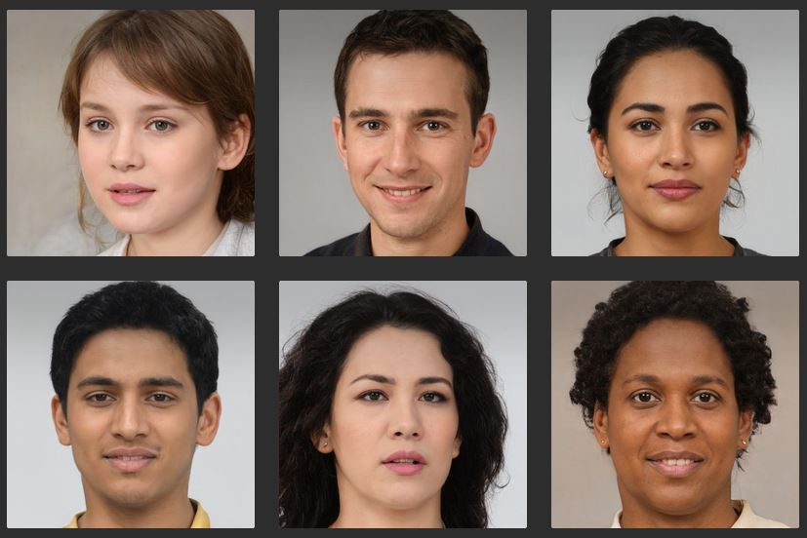
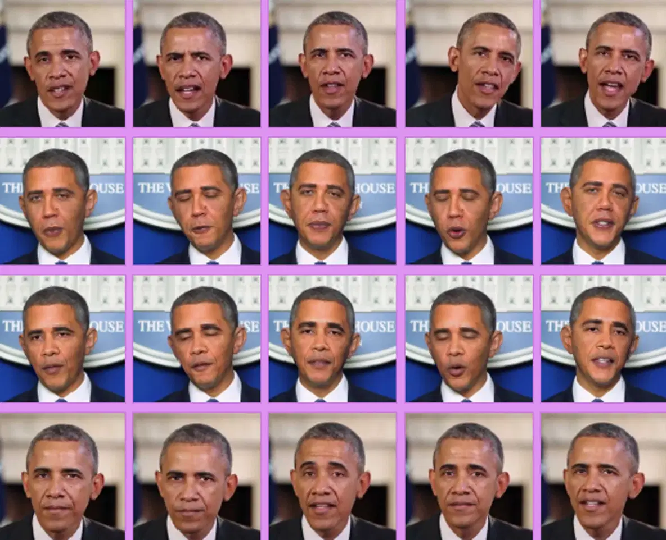
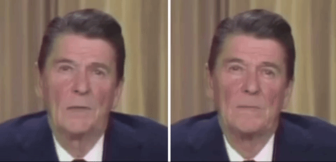
1. Introduction
Deepfakes are difficult to distinguish from real digital videos [1].
Deepfakes - CGI, Education, Arts[2].
Generated Deepfakes [3]
Deepfake Barak Obama
Deepfakes - for malicious purposes
Deepfakes – can cause harm to people, political institutions and society.
Deepfake of Ronald Reagan
[1] Bobby Chesney and Danielle Citron, "Deep Fakes A Looming Challenge for Privacy, Democracy, and National Security," 2019. [Online]. Available: https://ssrn.com/abstract=3213954. [Accessed 28 October 2019].
[2] Umur Aybars Ciftci, Ilke Demir and Lijun Yin, "FakeCatcher: Detection of Synthetic Portrait Videos using Biological Signals," arXiv preprint rXiv:1901.02212v2, August 2019.
[3] Generated Media, Inc., "Gallery of AI Generated Faces," 2019. [Online]. Available: https://generated.photos/faces.
2

Slide 4
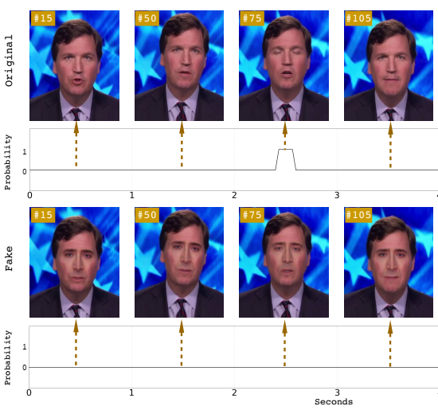
1. CONT...
There are different mechanisms to detect Deepfake
Yuezun et al. [4] - Eye blinking
Konstantinos et al. [5] - mimic eye blinking
Two weaknesses of current Deepfake detection [6, 7]:
Data preprocessing - Less emphasis on data preprocessing
Generality - Focus on a specific Deepfake generation techniques
[4] Yuezun Li, Ming-Ching Chang and Siwei Lyu, "In Ictu Oculi: Exposing A Generated Fake Face Videos by Detecting Eye Blinking," arXiv preprint arXiv:1806.02877v2, 2018.
[5] Konstantinos Vougioukas, Stavros Petridis and Maja Pantic, "Realistic Speech-Driven Facial Animation with GANs," International Journal of Computer Vision, vol. 128, p. 1398–1413, May 2020.
[6] Joshua Brockschmidt, Jiacheng Shang and Jie Wu, "On the Generality of Facial Forgery Detection," in 2019 IEEE 16th International Conference on Mobile Ad Hoc and Sensor Systems Workshops (MASSW), Monterey, CA, USA, IEEE, 2019, pp. 43-47.
[7] Polychronis Charitidis, Giorgos Kordopatis-Zilos, Symeon Papadopoulos and Ioannis Kompatsiaris, "A Face Preprocessing Approach For Improved Deepfake Detection," arXiv:2006.07084v1, June 2020.
3

Slide 5
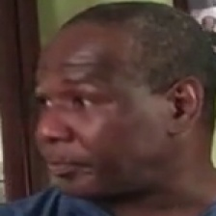
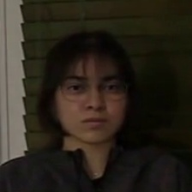
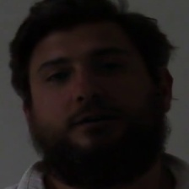
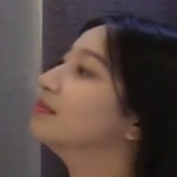
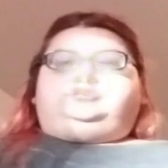
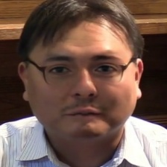
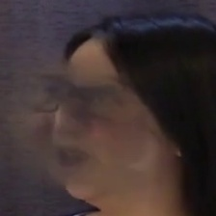
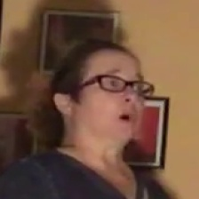
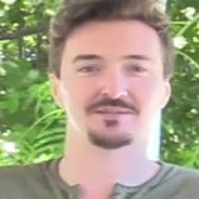
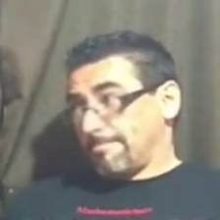
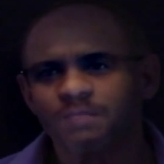
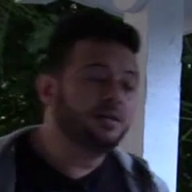
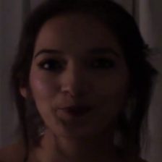
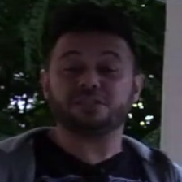
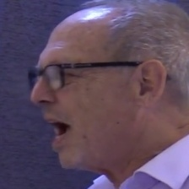
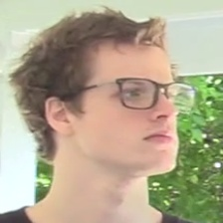
1. CONT...
We believe that there is a need to develop a general model that distinguishes current Deepfake artifacts and is trained on large datasets to learn as many Deepfake artifacts as possible.
Facial images in various environmental settings, skin color, and gender.
Hence, we propose a generalized architecture to detect Deepfake videos using Convolutional Vision Transformer
4

Slide 6
1.1 Motivation
Deepfakes - humiliate, blackmail,
misinforms, and defame a particular subject.
propaganda, scam
alter CT and MRI scans.
fingerprints to unlock multiple users’ devices.
Current detection mechanism: omit their data preprocessing
use very little dataset and
lack of generalized approach.
Our work aims to design and develop general Deepfake detection technique trained on more than 300,000 images
5

Slide 7



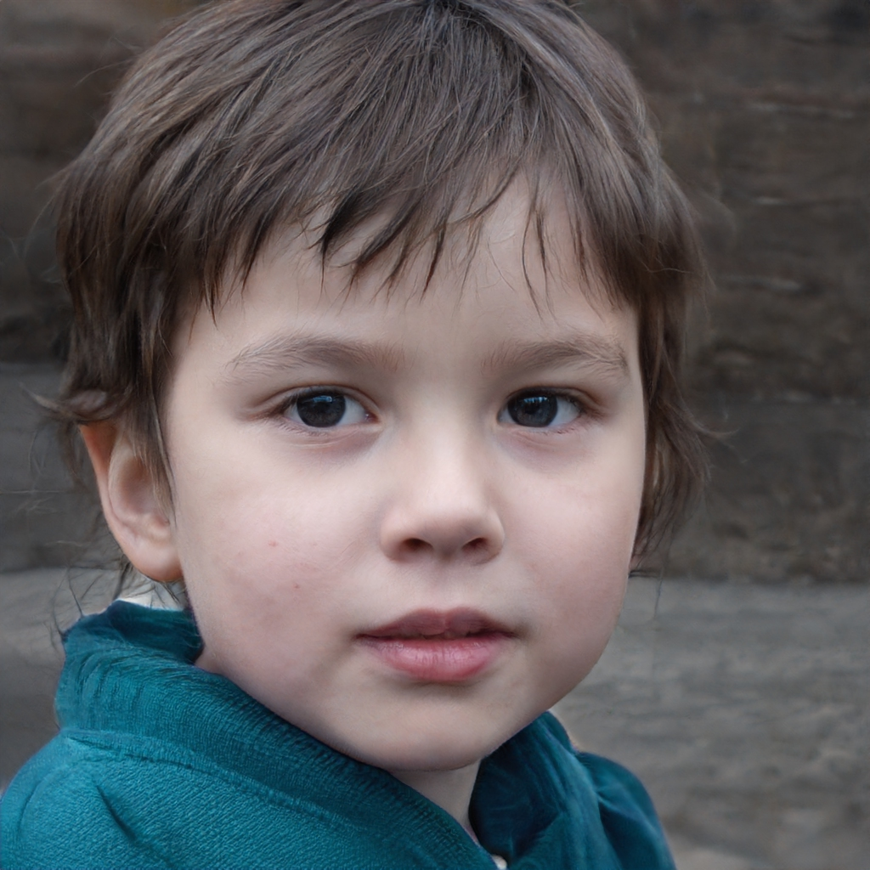

1.2 Statement of the problem
Deepfake poses an imminent threat.
It is blurring the line between what is real and fake.
Images generated by STYLEGAN [8]
6
[8] Tero Karras, Samuli Laine and Timo Aila, "A Style-Based Generator Architecture for Generative Adversarial Networks," arXiv:1812.04948, December 2018.

Slide 8
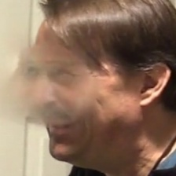
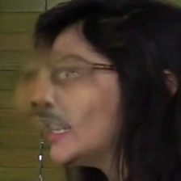
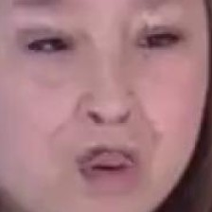



1.2 CONT...
Deepfake detection approaches:
Are in their early stages [3, 9],
Focus on the shortcomings of Deepfake generation techniques, and
1
2
3
Lack generality [10]
4
5
6
Inconsistent artifacts in Deepfakes
[4] Yuezun Li, Ming-Ching Chang and Siwei Lyu, "In Ictu Oculi: Exposing A Generated Fake Face Videos by Detecting Eye Blinking," arXiv preprint arXiv:1806.02877v2, 2018.
[9] Thanh Thi Nguyen, Cuong M. Nguyen, Dung Tien Nguyen, Duc Thanh Nguyen and Saeid Nahavandi, "Deep Learning for Deepfakes Creation and Detection," arXiv preprint arXiv:1909.11573v1, September 2019.
[10] Sakshi Agarwal and Lav R. Varshney, "Limits of Deepfake Detection: A Robust Estimation Viewpoint," arXiv:1905.03493v1, May 2020.
7

Slide 9
1.3 Objectives
General Objective
Design and develop a model for Deepfake video detection using Deep CNNs.
Specific Objectives
Review literatures and related work.
Identify the challenges of current Deepfake video detection.
Design a model for generalized Deepfake detection using Deep CNNs.
Develop the necessary algorithms.
Develop a prototype to validate the proposed model.
Select the appropriate dataset to test the developed prototype.
Test and evaluate the performance of the prototype.
8

Slide 10
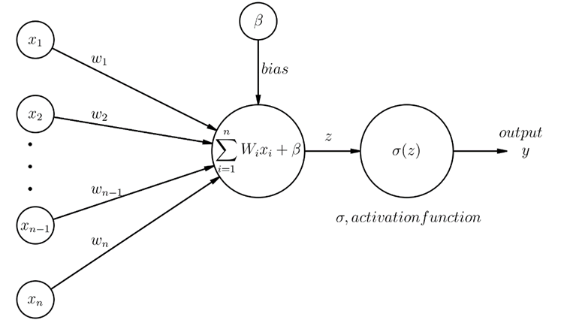
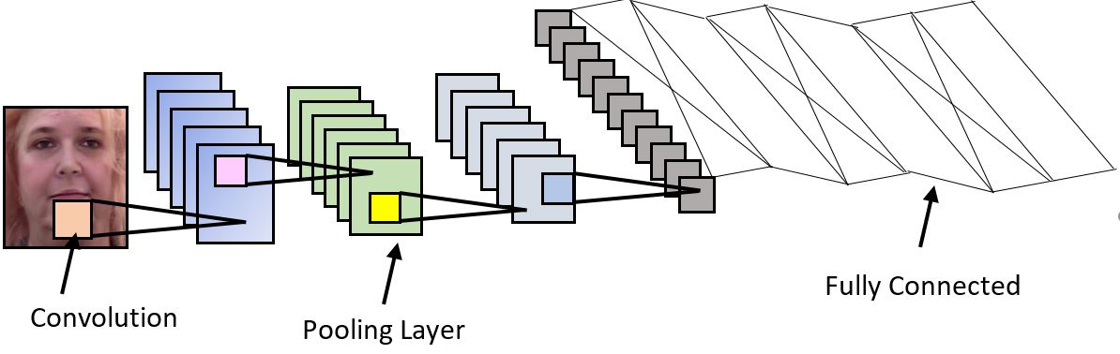
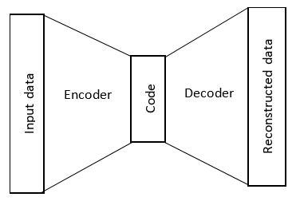
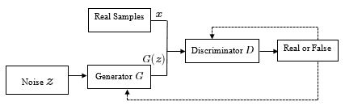
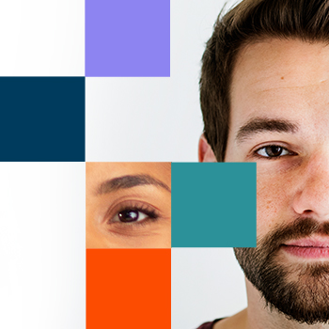
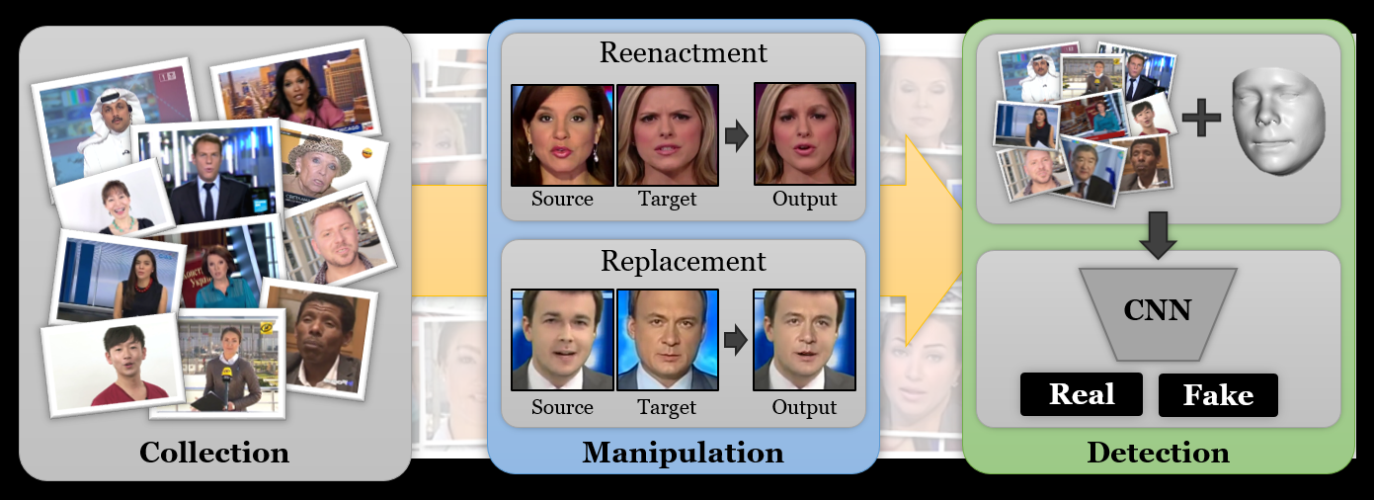
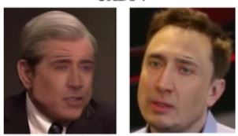
1.4 Methods
The following Deep learning techniques are reviewed, assessed and Deep CNN is used to design our model.
ANN
CNN
Autoencoder
GAN
Dataset:
DFDC [11, 12]
FaceForensics++ [13]
UADFV [14]
[11] Brian Dolhansky, Joanna Bitton, Ben Pflaum, Jikuo Lu, Russ Howes, Menglin Wang and Cristian Canton Ferrer, "The DeepFake Detection Challenge Dataset," arXiv:2006.07397v3, June 2020.
[12] Brian Dolhansky, Russ Howes, Ben Pflaum, Nicole Baram and Cristian Canton Ferrer, "The Deepfake Detection Challenge (DFDC) Preview Dataset," arXiv:1910.08854v2, October 2019.
[13] Andreas Rossler, Davide Cozzolino, Luisa Verdoliva, Christian Riess, Justus Thies and Matthias Nießner, "FaceForensics++: Learning to Detect Manipulated Facial Images," arXiv preprint arXiv:1901.08971v3, August 2019.
[14] Xin Yang, Yuezun Li and Siwei Lyu, "Exposing Deep Fakes Using Inconsistent Head Poses," arXiv preprint arXiv:1811.00661v2, November 2018.
9

Slide 11
1.5 Scope
The system focuses on building Deepfake detection model.
Its scope is Deepfake videos.
The proposed approach is not a replacement for the verification of real and fake videos.
Verify the authenticity of videos by analyzing malicious artifacts.
10

Slide 12
2. Related Work
Author | Year | Method | Technique | Dataset | Limitation
Darius et al. [15] | Sep 4, 2018 | MesoNet(Meso-4 and MesoInception-4) | Mesoscopic properties of an image. | FaceForensics and from online platforms. | Focuses on Deepfake and Face2Face. Focuses on face tampering.
Yuezun and Siwei [4] | May 22, 2019 | Compares the neighboring pixels to spot resolution inconsistencies that occur during face warping. VGG16, ResNet50, ResNet101 and ResNet152 | Artifacts in affine face warping as the distinctive feature to distinguish real and fake images | UADFV, and DeepfakeTIMIT | Current Deepfakes and GAN architectures can generating higher resolution images/frames.
[15] Darius Afchar, Vincent Nozick, Junichi Yamagishi and Isao Echizen, "MesoNet: a Compact Facial Video Forgery Detection Network," arXiv preprint rXiv:1809.00888v1, September 2018.
[4] Yuezun Li, Ming-Ching Chang and Siwei Lyu, "In Ictu Oculi: Exposing A Generated Fake Face Videos by Detecting Eye Blinking," arXiv preprint arXiv:1806.02877v2, 2018.

Slide 13
2. CONT…
Author | Year | Method | Technique | Dataset | Limitation
Huy et al. [16] | Oct 26, 2018 | Pre-trained VGG-19 network to extract latent features and CNN model. | Replay attacks, face swapping, facial reenactments and fully computer generated image spoofing. | Idiap REPLAY-ATTACK, Nguyen et al., Rahmouni et al. and MesoNet | Small dataset.
Daniel Mas Montserrat et al. [17] | May 4, 2020 | MTCNN to detect face region. CNN-RNN-GRU architecture. Automatic Frame Weighting (AFW) | emphasize the most reliable regions where faces have been detected. Computes weighted average of output logits of EffiecientNet model. | DFDC | Non face detection. Hence, their method doesn’t solve the problem.
[16] Falko Matern, Christian Riess and Marc Stamminger, "2019 Exploiting Visual Artifacts to Expose Deepfakes and Face Manipulations," in IEEE Winter Applications of Computer Vision Workshops (WACVW), Hawaii, January 2019.
[17] Daniel Mas Montserrat, Hanxiang Hao, S. K. Yarlagadda, Sriram Baireddy, Ruiting Shao, Janos Horvath, Emily Bartusiak, Justin Yang, David Guera, Fengqing Zhu and Edward J. Delp, "Deepfakes Detection with Automatic Face Weighting," in 2020 IEEE/CVF Conference on Computer Vision and Pattern Recognition Workshops (CVPRW), Seattle, WA, USA, IEEE, 2020, pp. 2851-2859.

Slide 14
2. CONT…
Author | Year | Method | Technique | Dataset | Limitation
Junyaup Kim et al. [18] | Dec 9, 2019 | ShallowNet, VGG-16, and Xception pre-trained. | evaluate the classification performance of the three DL models. | Disguised Faces in the Wild (DFW) 2018 | showed that current image classifiers are unable to correctly classify and detect Deepfakes.
Development of Deepfakes creation tools will make detection of Deepfake videos more challenging.
We shall deter such developments by thoroughly examining each Deepfake generation technique.
[18] Junyaup Kim, Siho Han and Simon S. Woo, "Classifying Genuine Face images from Disguised Face Images," in 2019 IEEE International Conference on Big Data (Big Data), Los Angeles, 2019.

Slide 15
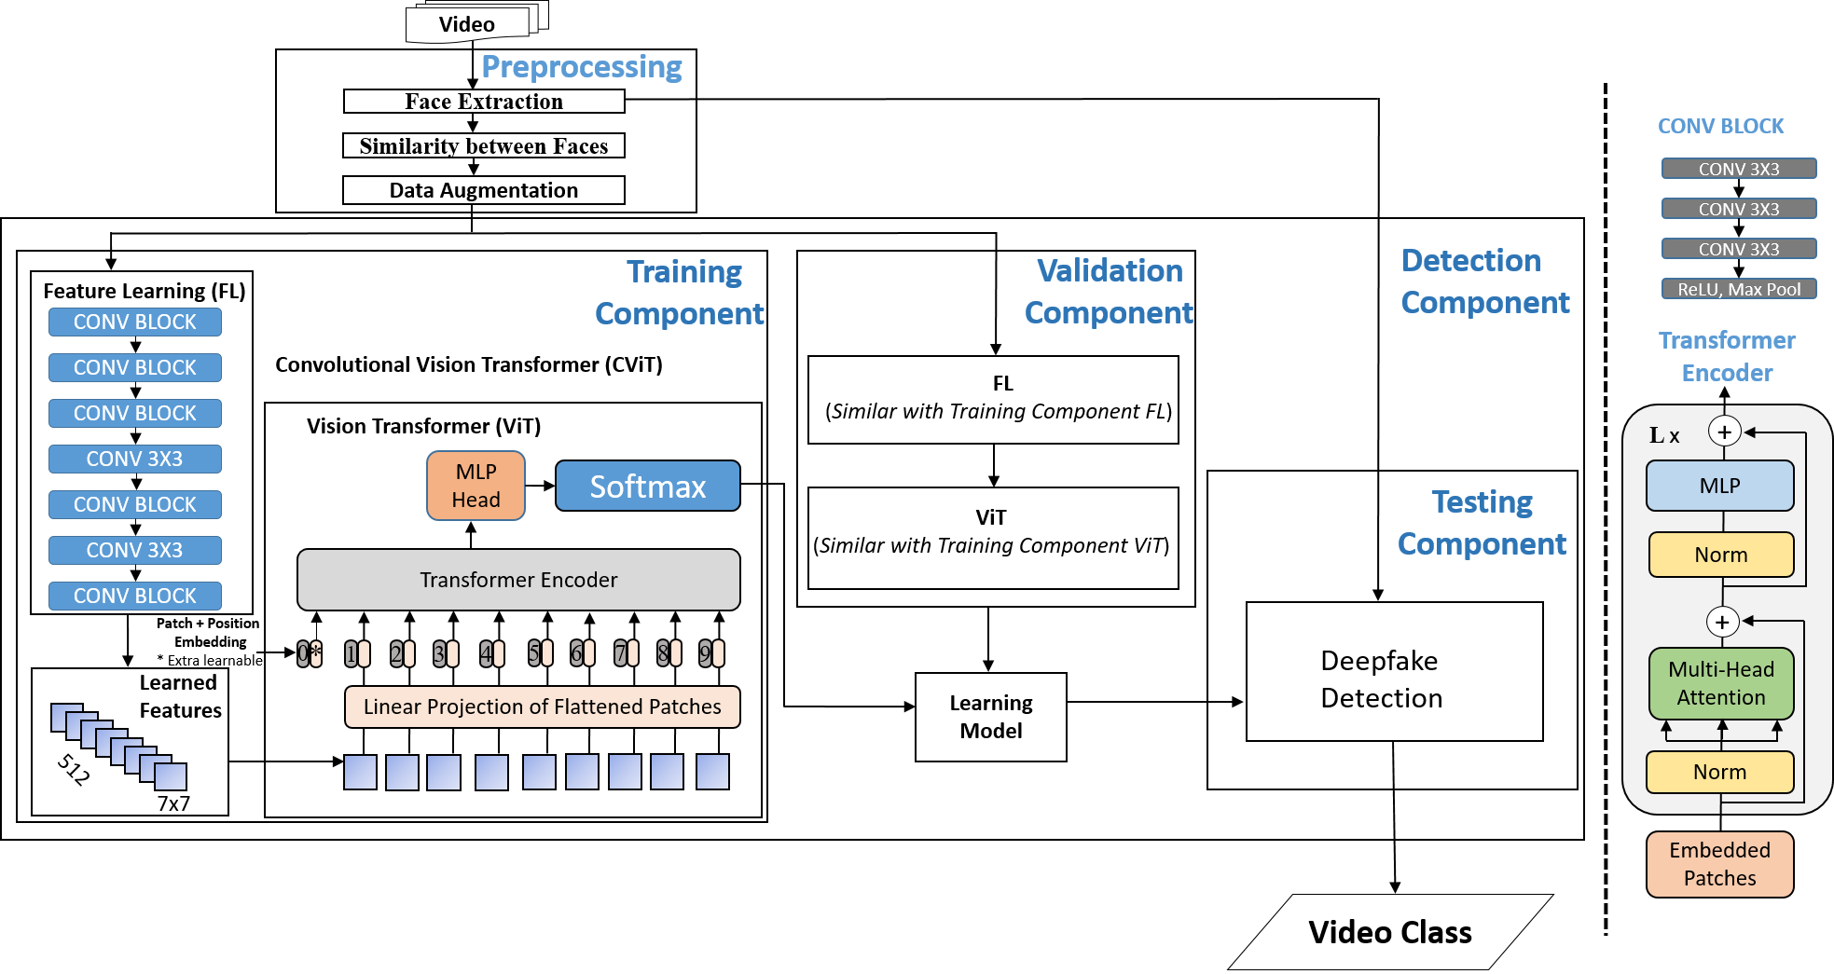
3. Design of Model for Deepfake Video Detection
3.1 The Deepfake Video
Detection Model
14

Slide 16
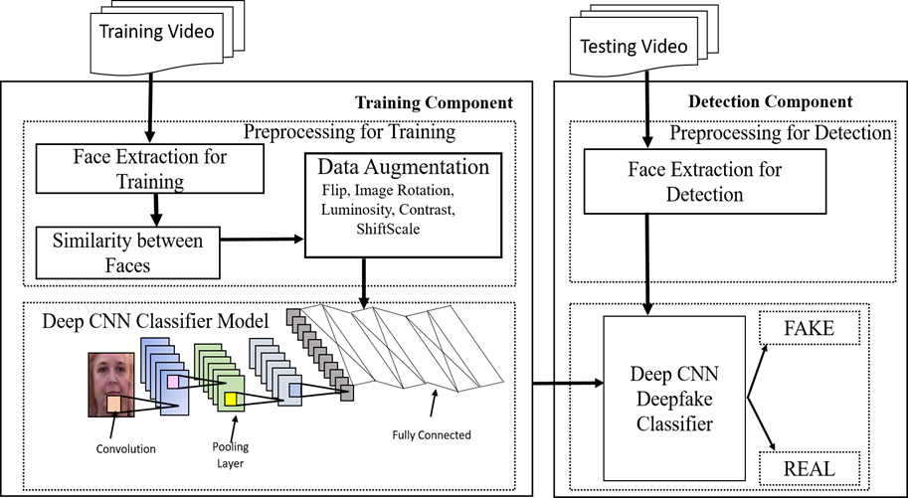
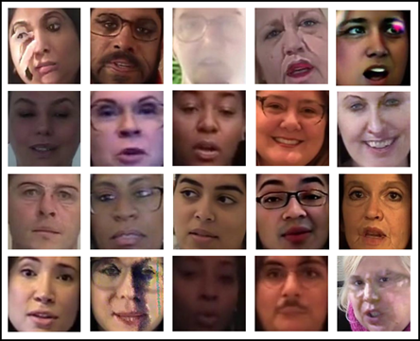
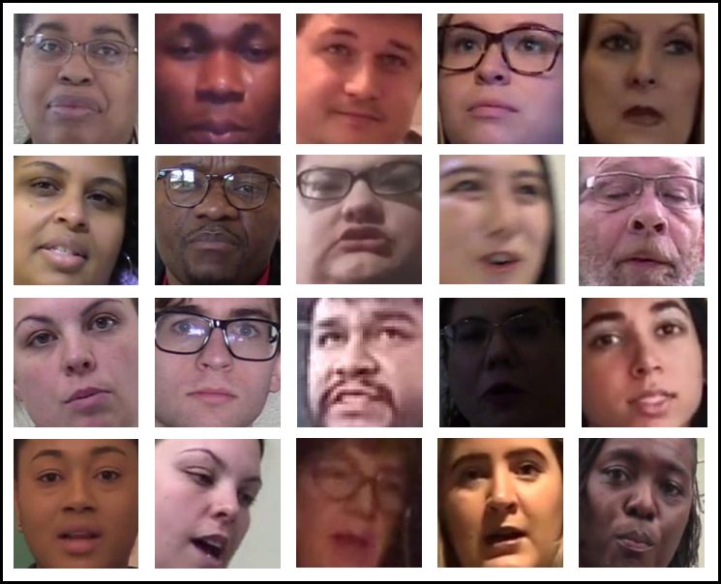
3.2 The Training Component
The principal part of the model
It is where the learning occurs
3.2.1 Face Extraction for Training
Prepares the video data into an image format for training
DFDC dataset is used
DFDC contains more than 100,000 videos
3.2.2 Similarity Between Faces
There are unmanipulated frames within fake videos.
They need to be removed from the training dataset
3.2.3 Data Augmentation
fake face images
real face images
Increases the dataset
15

Slide 17
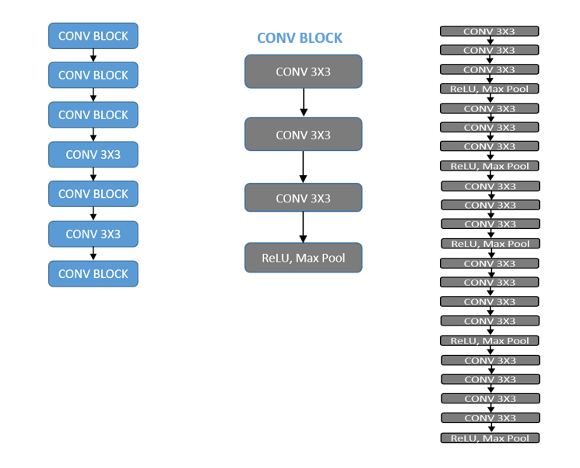
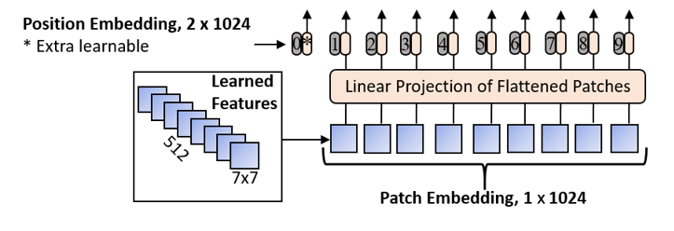
3.2 CONT…
3.2.4 Convolutional Vision Transformer Model
A binary classifier
18 convolutional layers, stride and padding of 1
ReLU activation function is used
CNN and ViT classifier model
16

Slide 18
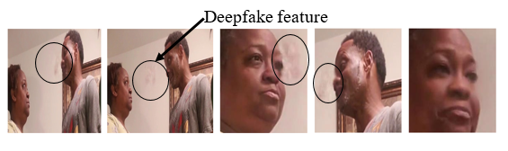
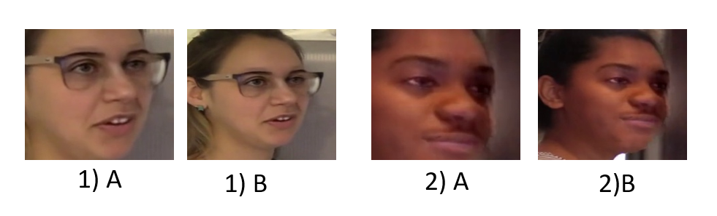
3.3 The Detection Component
Classify and determine the class of the faces extracted in a specific video
3.3.1 Face Extraction for Detection
Extracts 50 frames of face images from the test videos using face recognition DL libraries.
A Deepfake feature being copied from person A to person B
Face images used for training and testing
17

Slide 19
3.3 CONT…
3.3.2 CViT Classifier
The CViT classifier classifies the videos into a fake class or real class.
The sigmoid function maps the class probability of the value of the image between 0 and 1
Prediction – the class with the highest probability score is considered as the video class
18

Slide 20
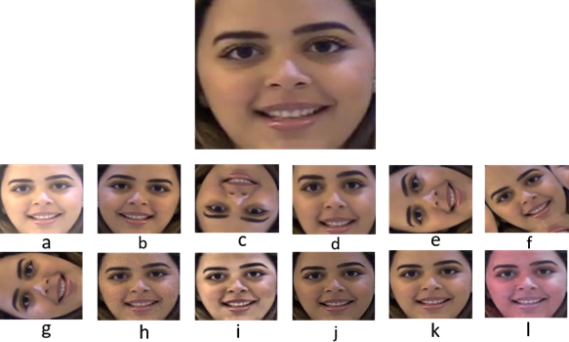
4. Implementation and Evaluation
4.1 Dataset Preparation
BlazeFace neural face detector [19], MTCNN [20] and face_recognition [21] DL libraries are used.
The face images are stored in a JPEG file
112,378 facial images for training, 24,898 for validation and 24,898 for testing
90% data augmentation.
308,130 total facial images for training
Data Augmentation
[19] Valentin Bazarevsky, Yury Kartynnik, Andrey Vakunov, Karthik Raveendran and Matthias Grundmann, "BlazeFace: Sub-millisecond Neural Face Detection on Mobile GPUs," arXiv:1907.05047v2, Jul 2019.
[20] Timesler, "Pretrained Pytorch face detection (MTCNN) and recognition (InceptionResnet) models," [Online]. Available: https://github.com/timesler/facenet-pytorch. [Accessed 6 10 2020].
[21] Adam Geitgey, "The world's simplest facial recognition api for Python and the command line," Github, [Online]. Available: https://github.com/ageitgey/face_recognition. [Accessed 24 September 2020].
19

Slide 21
4.2 Tools and Experiment Setup
Python programming language.
Albumentation, BlazeFace, face_recognition, OpenCV-Python and NumPy
Kaggle.com - provides free access to NVIDIA TESLA P100 GPUs
Google Cloud Platform - NVIDIA Tesla T4 GPU that runs on the Google Deep Learning Image
Lenovo Windows 10, Core i7 7 Gen for data acquisition, and face extraction
20

Slide 22


4.3 Model Evaluation
To determine the classification accuracy of our model, we used a log loss function.
$$\text{LogLoss}\text{ = }\text{−}\frac{\text{1}}{\text{n}}\sum_{\text{1}}^{\text{n}}{\left[{\text{y}}_{\text{i}}\text{log}{ \text{(}{\hat{\text{y}}}_{\text{i}}\text{)}}\text{+}\text{log}\text{(}{1−{\text{y}}_{\text{i}}\text{)}}\text{log}\text{(}{1−{\hat{\text{y}}}_{\text{i}}\text{)}}\right]}$$
Where n is the number of videos being predicted, $\hat{{\text{y}}_{\text{i}}}$ is the predicted probability of the video being FAKE, ${\text{y}}_{\text{i}}$ is 1 if the video is FAKE, 0 if REAL, log$\text{()}$ is the natural (base e) logarithm
We used Receiver Operating Characteristic (ROC) and Area Under the ROC Curve (AUC) metrics [137] to measure our model capacity.
21

Slide 23
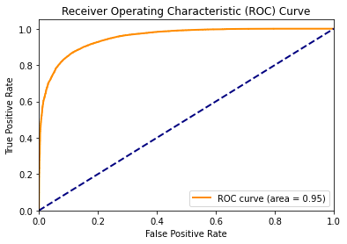
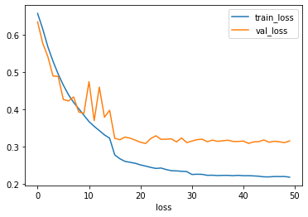
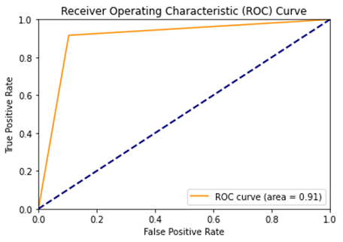
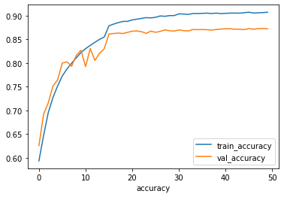
5. Training and Experiment Results
We tested the model on 24,898 facial images
AUC = 0.95
Accuracy = 87.25%
ROC curve for 24,898 images on test set
Train and valid loss progression
400 unseen DFDC videos
AUC = 0.91
Accuracy = 93
Loss = 0.3
ROC curve for 400 unseen videos
Train and valid accuracy progression
22

Slide 24
5. CONT…
Accuracy of our model and other Deepfake detection models on the DFDC dataset
Method | Validation | Test
CNN and RNN-GRU GRU [114] | 92.61% | 91.88%
Our Deepfake Classifier | 87.25% | 93%
AUC performance of our model and other Deepfake detection models on UADFV dataset
Method | UADFV | FaceForensics++ | FaceForensics++
 |  | FaceSwap | Face2Face
MesoNet | 84.3% | 96% | 92%
MesoInception | 82.4% | 98% | 93.33
Our Deepfake Classifier | 86% | 75% | 79%
23

Slide 25
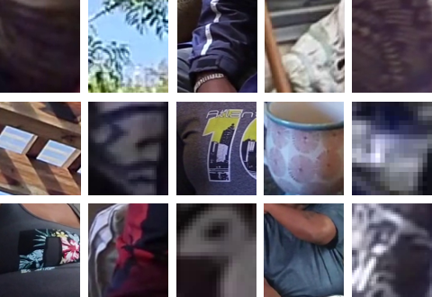
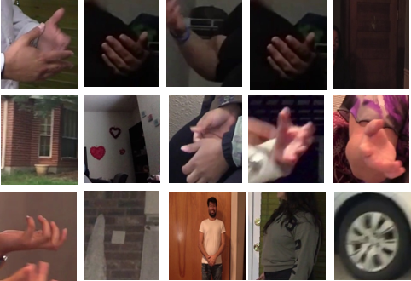
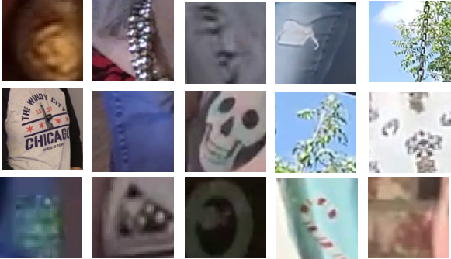
5.1 Effects of Data Processing During Classification
MTCNN non face region detection
BlazeFace non face region detection
face_recognition non face region detection
Without preprocessing our models’ accuracy dropped to 69.5 percent, and the loss value increased to 0.4.
To reduce the false positives we used face_recognition as a filter.
24

Slide 26
6. Conclusion and Future Work
6.1 Conclusion
We have designed and developed a generalized model for Deepfake video detection using CNNs andViT
We gave equal emphasis on our data preprocessing during training and classification.
We used the largest available dataset for Deepfake detection.
Our new Deepfake detection model has the potential to be used in the detection of Deepfakes intended for malicious intents
25

Slide 27
6.2 Contribution
The contribution of this thesis work are:
Generalized Deepfake detection model that detects Deepfakes with 93 percent accuracy on the DFDC dataset.
Our Deepfake detection model is capable of detecting Deepfakes in various settings.
Data preprocessing during training and classification enhances Deepfake detection model accuracy.
26

Slide 28
6.2 CONT…
Adding padding to the face region at prediction time increases Deepfake detection accuracy.
Choice of a face detection algorithms can affect a Deepfake detection model’s accuracy.
27

Slide 29
Thank You

